Slide 1

AI-Powered Health Monitoring System
Presented by: Tawana Msebele
14 July 2025

Slide 2

Introduction & Objectives
Background
Objective
Addressing the critical need for continuous health monitoring, especially in underserved areas
Build a system to monitor health vitals and detect anomalies using AI
Outcome
Real-time data visualization and actionable health recommendations

Slide 3

Problem
Rural and remote areas lack access to continuous health monitoring
Manual monitoring is insufficient for early detection of health risks
Need for an automated, scalable, and user-friendly solution

Slide 4



Solution Overview
Data Simulation
Anomaly Detection
User Interface
AI-powered system simulating real-time health data
Using Isolation Forest algorithm to identify health risks
Streamlit dashboard with exportable reports

Slide 5

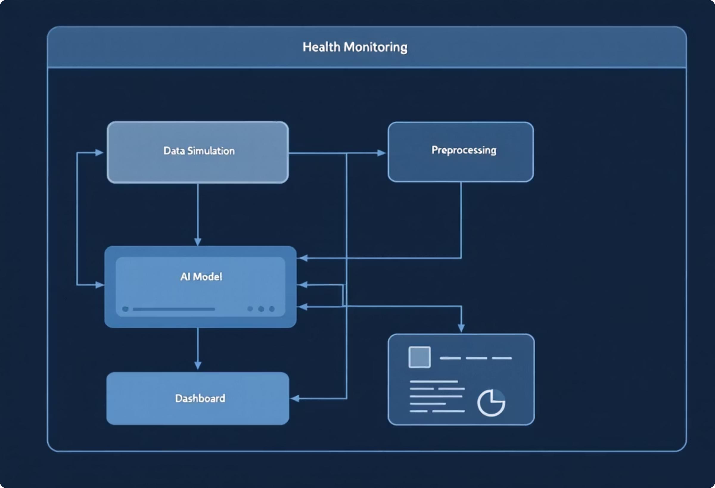
System Architecture
1
Sensors/Input
Data collection
2
Preprocessing
Data cleaning
3
AI Model
Anomaly detection
4
Dashboard
Visualization & reports

Slide 6
Key Features & Technologies
Features
Technologies
Simulated health data generation
Python 3
Real-time anomaly detection
Streamlit for UI development
Health recommendations based on vitals
Scikit-learn for machine learning
Interactive visualizations
Pandas & NumPy for data processing
Report export functionality (CSV)
Matplotlib & Seaborn for visualization

Slide 7
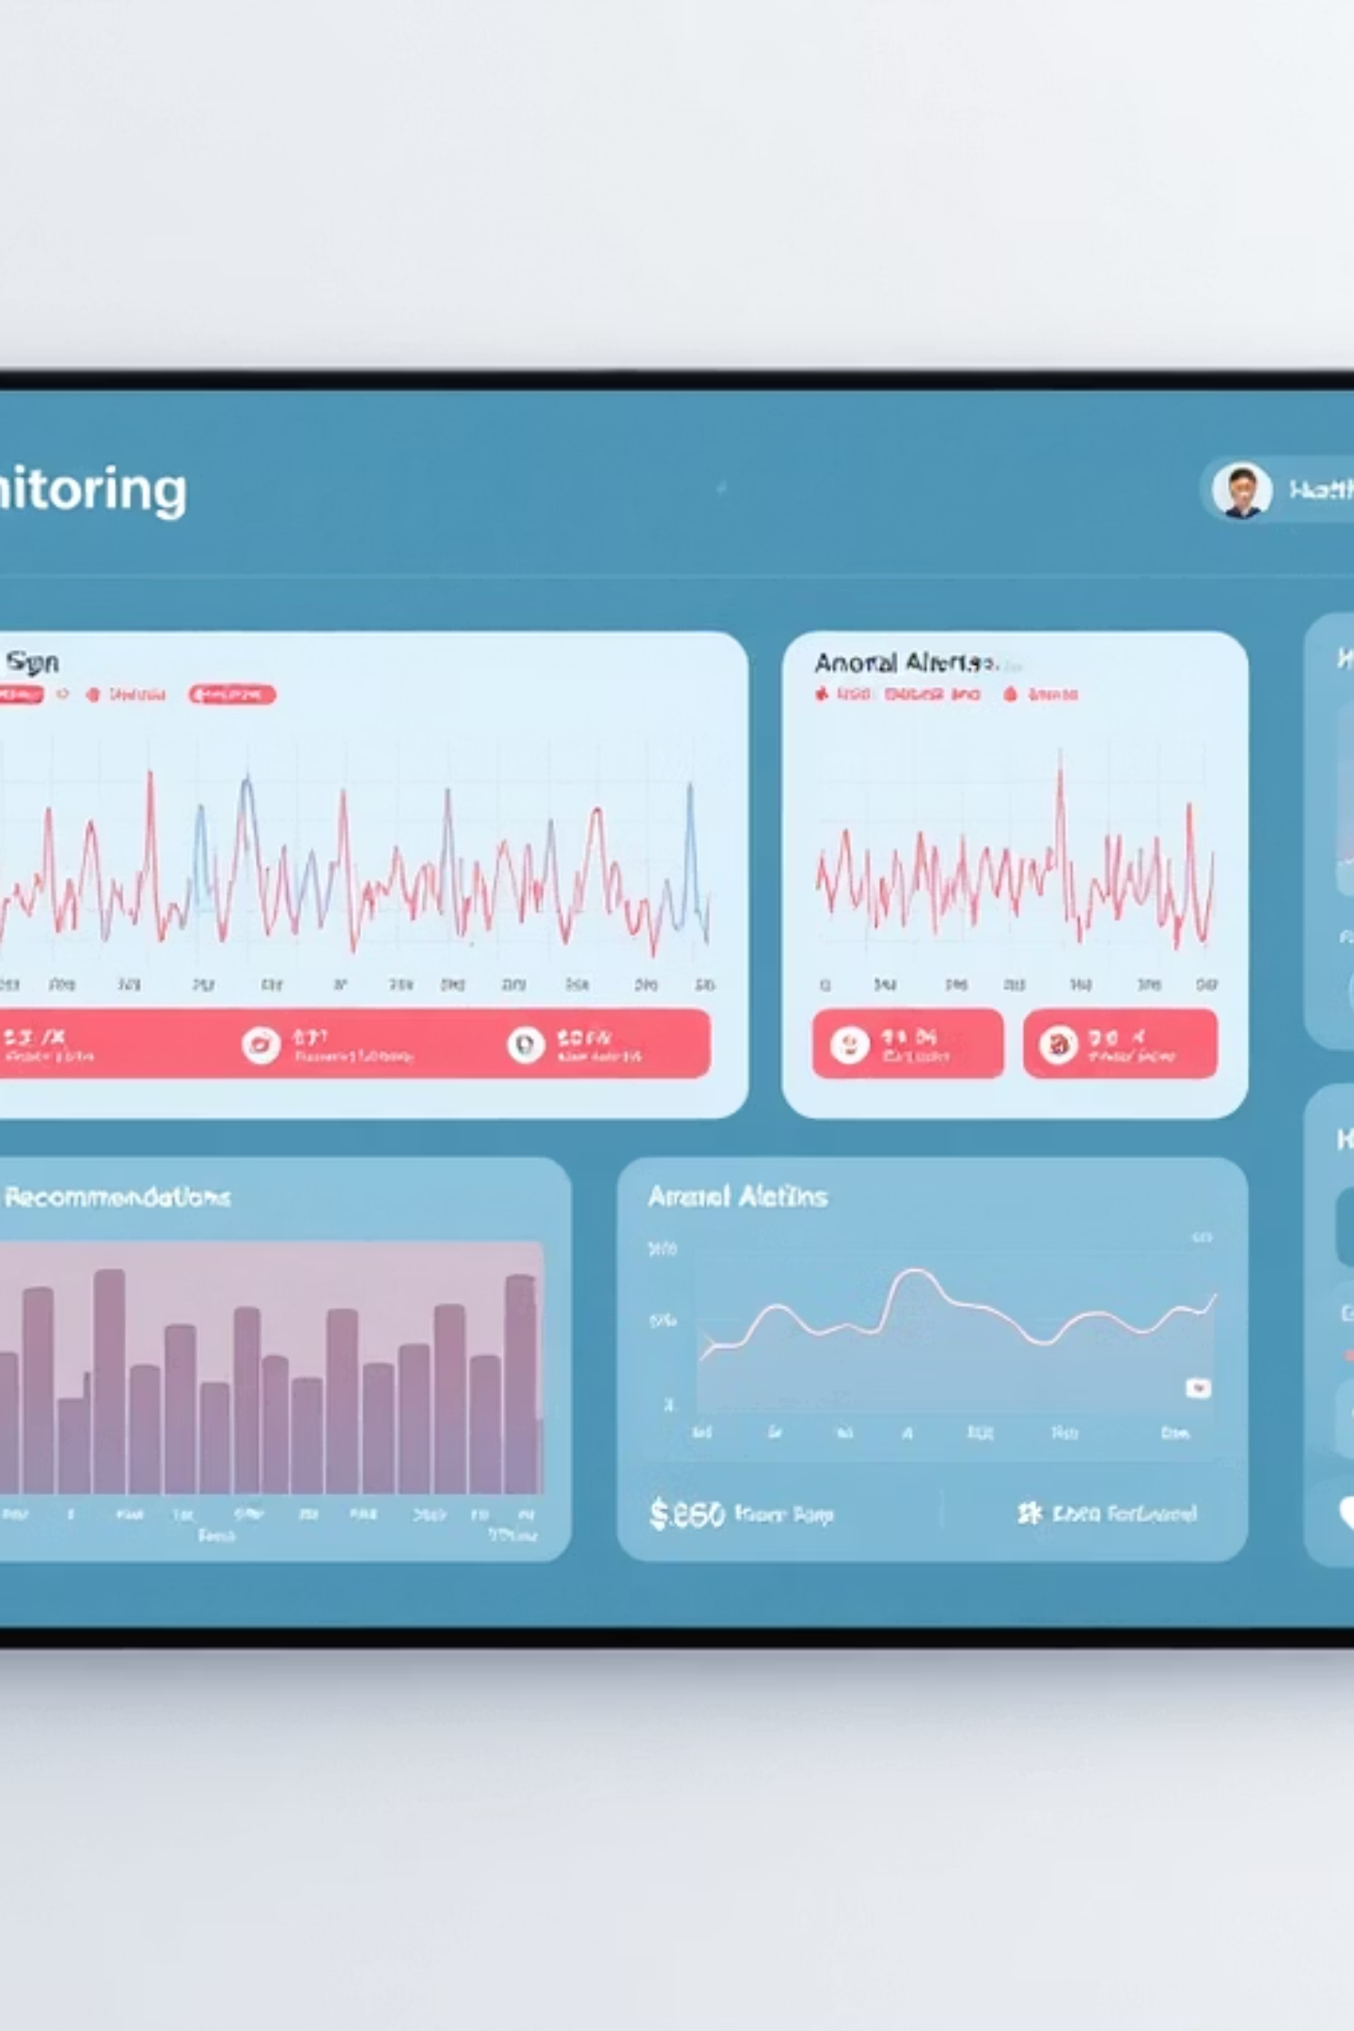
Results & Demonstration
The system successfully demonstrates:
Real-time dashboard display with vital signs monitoring
Accurate anomaly detection on simulated health data
Contextual health recommendations based on detected patterns
Exportable reports for healthcare provider review

Slide 8
Future Enhancements & Conclusion
1
2
IoT Integration
Advanced AI
Connect with real health sensors
Implement LSTM models for better prediction
3
4
Mobile Deployment
Healthcare Integration
Develop as mobile/web app with alerts
Connect with providers' systems
Thank you! Questions?

